Slide 1
Architectural patterns
Patterns are a means of representing, sharing and reusing knowledge.
An architectural pattern is a stylized description of good design practice, which has been tried and tested in different environments.
Patterns should include information about when they are and when the are not useful.
Patterns may be represented using tabular and graphical descriptions.

Slide 2
The Model-View-Controller (MVC) pattern
Name | MVC (Model-View-Controller)
Description | Separates presentation and interaction from the system data. The system is structured into three logical components that interact with each other. The Model component manages the system data and associated operations on that data. The View component defines and manages how the data is presented to the user. The Controller component manages user interaction (e.g., key presses, mouse clicks, etc.) and passes these interactions to the View and the Model. See Figure 6.3.
Example | Figure 6.4 shows the architecture of a web-based application system organized using the MVC pattern.
When used | Used when there are multiple ways to view and interact with data. Also used when the future requirements for interaction and presentation of data are unknown.
Advantages | Allows the data to change independently of its representation and vice versa. Supports presentation of the same data in different ways with changes made in one representation shown in all of them.
Disadvantages | Can involve additional code and code complexity when the data model and interactions are simple.

Slide 3
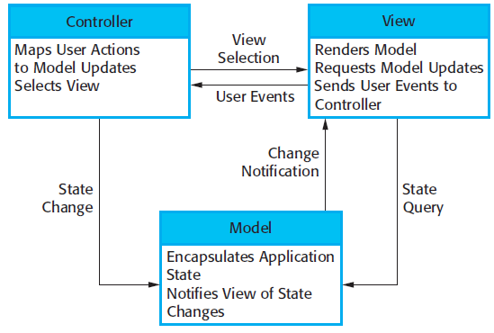
The organization of the Model-View-Controller
Conceptual view
Notes:
adding a new view or changing an existing view can be done without any changes to the underlying data in the model.

Slide 4
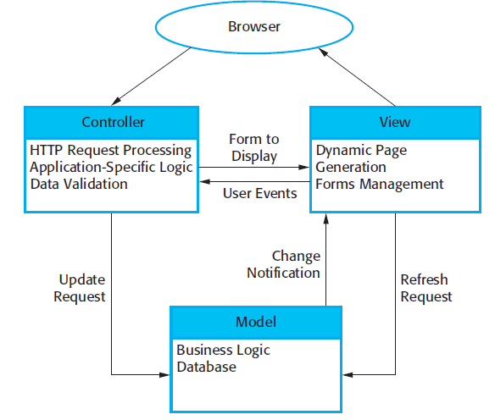
Web application architecture using the MVC pattern
This pattern is the basis of interaction management in many web-based systems
and is supported by most language frameworks.

Slide 5
Layered architecture
Used to model the interfacing of sub-systems.
system functionality is organized into separate layers
Organises the system into a set of layers each of which provide a set of services.
Each layer relies on the services offered by the layer beneath
Supports the incremental development of sub-systems in different layers.
When a layer interface changes, only the adjacent layer is affected.
Architecture is changeable and portable
So long as its interface is unchanged, a layer can be replaced by another, equivalent layer
when layer interfaces change or new facilities are added to a layer, only the adjacent layer is affected
Notes:
As layered systems localize machine dependencies, this makes it easier to provide multi-platform implementations of an application system

Slide 6
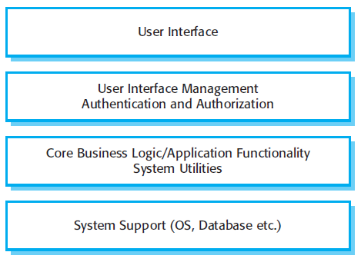
A generic layered architecture

Slide 7
The Layered architecture pattern
Name | Layered architecture
Description | Organizes the system into layers with related functionality associated with each layer. A layer provides services to the layer above it so the lowest-level layers represent core services that are likely to be used throughout the system.
Example | A layered model of a system for sharing copyright documents held in different libraries, as shown in Figure 6.7.
When used | Used when building new facilities on top of existing systems; when the development is spread across several teams with each team responsibility for a layer of functionality; when there is a requirement for multi-level security.
Advantages | Allows replacement of entire layers so long as the interface is maintained. Redundant facilities (e.g., authentication) can be provided in each layer to increase the dependability of the system.
Disadvantages | In practice, providing a clean separation between layers is often difficult and a high-level layer may have to interact directly with lower-level layers rather than through the layer immediately below it. Performance can be a problem because of multiple levels of interpretation of a service request as it is processed at each layer.

Slide 8
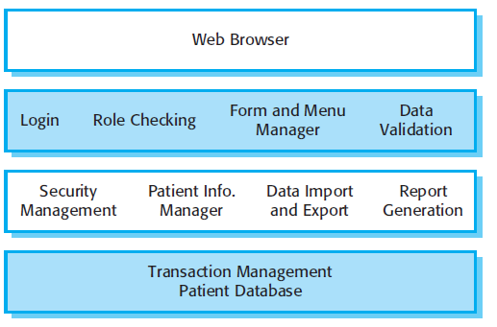
Example: mental health clinic patient monitoring system

Slide 9
Example: iLearn
Notes:
when layer interfaces change or new facilities are added to a layer, only the adjacent layer is affected. As layered systems localize machine dependencies, this makes it easier to provide multi-platform implementations of an application system
supports the incremental development of systems
also changeable and portable.
system functionality is organized into separate layers

Slide 10
Repository architecture
Sub-systems must exchange data.
This may be done in two ways:
Shared data is held in a central database or repository and may be accessed by all sub-systems;
Each sub-system maintains its own database and passes data explicitly to other sub-systems.
an efficient way of sharing large amounts of data.
When large amounts of data are to be shared, the repository model of sharing is most commonly used a this is an efficient data sharing mechanism.
Examples: command and control systems, management information systems, Computer-Aided Design (CAD) systems, and interactive development environments for software.
Notes:
Examples include command and control systems, management information systems, Computer-Aided Design (CAD) systems, and interactive development environments for software.

Slide 11
The Repository pattern
Name | Repository
Description | All data in a system is managed in a central repository that is accessible to all system components. Components do not interact directly, only through the repository.
Example | example of an IDE where the components use a repository of system design information. Each software tool generates information which is then available for use by other tools.
When used | You should use this pattern when you have a system in which large volumes of information are generated that has to be stored for a long time. You may also use it in data-driven systems where the inclusion of data in the repository triggers an action or tool.
Advantages | Components can be independent—they do not need to know of the existence of other components. Changes made by one component can be propagated to all components. All data can be managed consistently (e.g., backups done at the same time) as it is all in one place.
Disadvantages | The repository is a single point of failure so problems in the repository affect the whole system. May be inefficiencies in organizing all communication through the repository. Distributing the repository across several computers may be difficult.

Slide 12
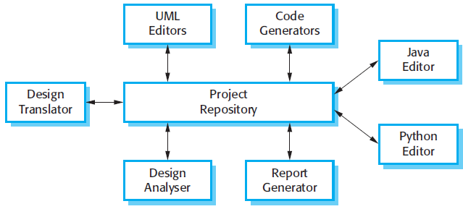
A repository architecture for an IDE
Repository here is version controlled that keep track of changes

Slide 13
Client-server architecture
Distributed system model which shows how data and processing is distributed across a range of components.
Can be implemented on a single computer.
Set of stand-alone servers which provide specific services such as printing, data management, etc.
Set of clients which call on these services.
Network which allows clients to access servers.
Notes:
Client–server architectures are usually thought of as distributed systems architectures, but the logical model of independent services running on separate servers can be implemented on a single computer.

Slide 14
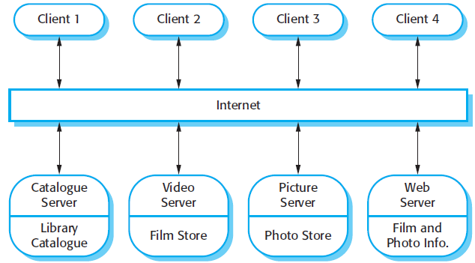
A client–server architecture for a film library
The client program is simply an integrated user interface, constructed using a web browser, to access these services.
Servers manage and display different types of media
Notes:
The client program is simply an integrated user interface, constructed using a web browser, to access these services.

Slide 15
The Client–server pattern
Name | Client-server
Description | In a client–server architecture, the functionality of the system is organized into services, with each service delivered from a separate server. Clients are users of these services and access servers to make use of them.
Example | Figure 6.11 is an example of a film and video/DVD library organized as a client–server system.
When used | Used when data in a shared database has to be accessed from a range of locations. Because servers can be replicated, may also be used when the load on a system is variable.
Advantages | The principal advantage of this model is that servers can be distributed across a network. General functionality (e.g., a printing service) can be available to all clients and does not need to be implemented by all services.
Disadvantages | Each service is a single point of failure so susceptible to denial of service attacks or server failure. Performance may be unpredictable because it depends on the network as well as the system. May be management problems if servers are owned by different organizations.

Slide 16
The most important advantage of the client–server model is that it is a distributed architecture.
Effective use can be made of networked systems with many distributed processors.
An important benefit is separation and independence.
It is easy to add a new server and integrate it with the rest of the system or to upgrade servers transparently without affecting other parts of the system
Clients may have to know the names of the available servers and the services they provide. However, servers do not need to know the identity of clients or how many clients are accessing their services.

Slide 17
Pipe and filter architecture
Functional transformations process their inputs to produce outputs.
Data flows from one to another and is transformed as it moves through the sequence.
Each processing step is implemented as a transform.
Input data flows through these transforms until converted to output.
The transformations may execute sequentially or in parallel. The data can be processed by each transform item by item or in a single batch.
Variants of this approach are very common. When transformations are sequential, it is a batch sequential model (extensively used in data processing systems.)
E.g. billing system
Not really suitable for interactive systems.
Pipe and filter systems are best suited to batch processing systems and embedded systems where there is limited user interaction.
common architecture for data-processing systems such as billing systems

Slide 18
The pipe and filter pattern
Name | Pipe and filter
Description | The processing of the data in a system is organized so that each processing component (filter) is discrete and carries out one type of data transformation. The data flows (as in a pipe) from one component to another for processing.
Example | Figure 6.13 is an example of a pipe and filter system used for processing invoices. A common architecture for data-processing systems such as billing systems.
When used | Commonly used in data processing applications (both batch- and transaction-based) where inputs are processed in separate stages to generate related outputs.
Advantages | Easy to understand and supports transformation reuse. Workflow style matches the structure of many business processes. Evolution by adding transformations is straightforward. Can be implemented as either a sequential or concurrent system.
Disadvantages | The format for data transfer has to be agreed upon between communicating transformations. Each transformation must parse its input and unparse its output to the agreed form. This increases system overhead and may mean that it is impossible to reuse functional transformations that use incompatible data structures.
Notes:
common architecture for data-processing systems such as billing systems.
. Data flows from one to another and is transformed as it moves through the sequence.

Slide 19
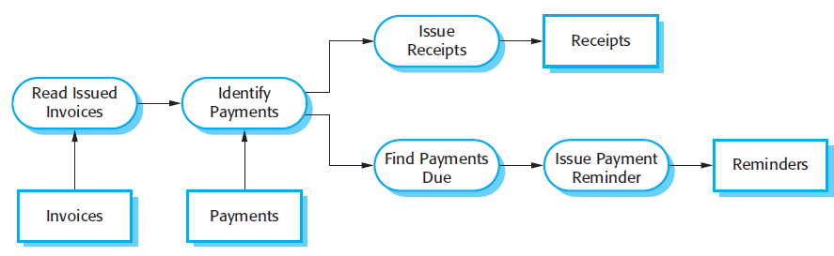
An example of the pipe and filter architecture
An organization has issued invoices to customers. Once a week, payments that have been made are reconciled with the invoices
For the paid invoices a receipt is issued. For the invoices not paid within the allowed payment time, a reminder is issued

Slide 21
Application architectures
Application systems are designed to meet an organisational need.
As businesses have much in common, their application systems also tend to have a common architecture that reflects the application requirements.
A generic application architecture is an architecture for a type of software system that may be configured and adapted to create a system that meets specific requirements.

Slide 22
Use of application architectures
As a starting point for architectural design.
As a design checklist.
As a way of organising the work of the development team.
As a means of assessing components for reuse.
As a vocabulary for talking about application types.

Slide 23
Examples of application types
Data processing applications
Data driven applications that process data in batches without explicit user intervention during the processing.
Transaction processing applications
Data-centred applications that process user requests and update information in a system database.
Event processing systems
Applications where system actions depend on interpreting events from the system’s environment.
Language processing systems
Applications where the users’ intentions are specified in a formal language that is processed and interpreted by the system.

Slide 24
Application type examples
Examples on transaction processing and language processing systems.
Transaction processing systems
E-commerce systems;
Reservation systems.
All systems that involve interaction with a shared database can be considered to be transaction-based information systems
Language processing systems
Compilers;
Command interpreters.

Slide 25
Transaction processing systems
Transaction processing applications are database-centered applications that process user requests for information and update the information in a database.
From a user perspective a transaction is:
Any coherent sequence of operations that satisfies a goal;
For example - find the times of flights from London to Paris.
Transaction processing systems are usually interactive systems in which users make asynchronous requests for service. These requests are then processed by a transaction manager.

Slide 26

The structure of transaction processing applications
First a user makes a request to the system through an I/O processing component.
The request is processed by some application specific logic.
A transaction is created and passed to a transaction manager, which is usually embedded in the database management system.
After the transaction manager has ensured that the transaction is properly completed, it signals to the application that processing has finished.

Slide 27
An example of a transaction: a customer request to withdraw money from a bank account using an ATM.
getting details of the customer’s account,
Checking the balance,
modifying the balance by the amount withdrawn,
and sending commands to the ATM to deliver the cash.
Until all of these steps have been completed, the transaction is incomplete and the customer accounts database is not changed
Notes:
All of the operations in a transaction have to be completed before the database changes are made permanent.

Slide 28
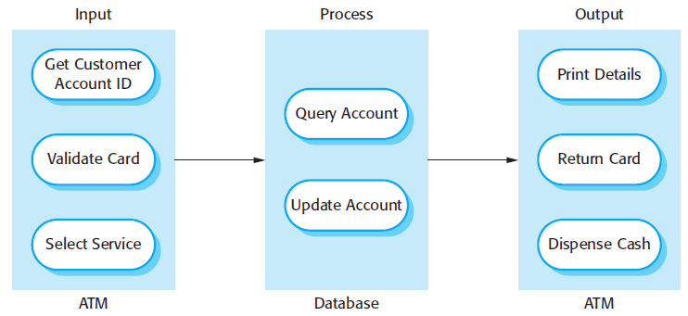
The software architecture of an ATM system
Transaction processing systems may be organized as a ‘pipe and filter’ architecture with system components responsible for input, processing, and output
Notes:
All of the operations in a transaction have to be completed before the database changes are made permanent.

Slide 29
Information systems architecture
Information systems have a generic architecture that can be organised as a layered architecture.
These are transaction-based systems as interaction with these systems generally involves database transactions.
Layers include:
The user interface
User communications
Information retrieval
System database

Slide 30
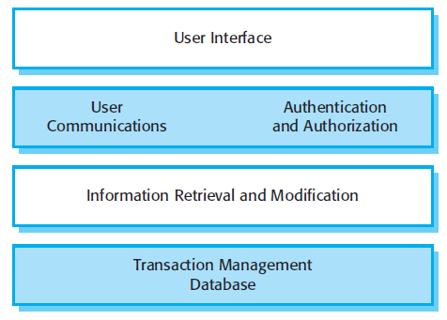
Layered information system architecture
A general model of information system
Notes:
All systems that involve interaction with a shared database can be considered to be transaction-based information systems.
An information system allows controlled access to a large base of information,

Slide 31
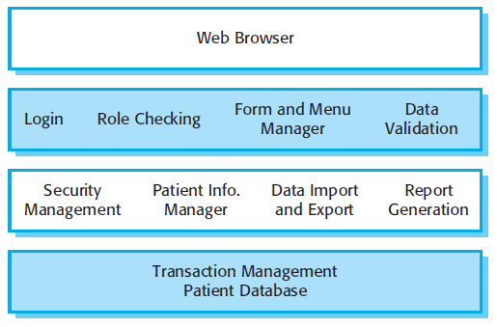
The architecture of the MHC-PMS
Notes:
Mentcare: maintains and manages details of patients who are consulting specialist doctors about mental health problems.
1. The top layer is a browser-based user interface.
2. The second layer provides the user interface functionality that is delivered through the web browser. It includes components to allow users to log in to the
system and checking components that ensure that the operations they use are allowed by their role. This layer includes form and menu management components that present information to users, and data validation components that check information consistency.
3. The third layer implements the functionality of the system and provides components that implement system security, patient information creation and
updating, import and export of patient data from other databases, and report generators that create management reports.
4. Finally, the lowest layer, which is built using a commercial database management system, provides transaction management and persistent data storage.

Slide 32
Web-based information systems
Information and resource management systems are now usually web-based systems where the user interfaces are implemented using a web browser.
For example, e-commerce systems are Internet-based resource management systems that accept electronic orders for goods or services and then arrange delivery of these goods or services to the customer.
In an e-commerce system, the application-specific layer includes additional functionality supporting a ‘shopping cart’ in which users can place a number of items in separate transactions, then pay for them all together in a single transaction.
Notes:
Information and resource management systems are sometimes also transaction processing systems.
For example, e-commerce systems …..

Slide 33
Server implementation
These systems are often implemented as multi-tier client server/architectures
The web server is responsible for all user communications, with the user interface implemented using a web browser;
The application server is responsible for implementing application-specific logic as well as information storage and retrieval requests;
The database server moves information to and from the database and handles transaction management.
3 tiers: web server, application server, database server

Slide 34
Language processing systems
Accept a natural or artificial language as input and generate some other representation of that language.
High level language to machine code (compiler)
XML data description into commands to query a database
May include an interpreter to act on the instructions in the language that is being processed.
Used in situations where the easiest way to solve a problem is to describe an algorithm or describe the system data
Meta-case tools process tool descriptions, method rules, etc and generate tools.

Slide 35
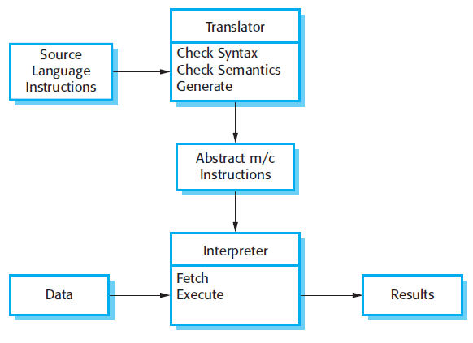
The architecture of a language processing system

Slide 36
Compiler components
A lexical analyzer, which takes input language tokens and converts them to an internal form.
A symbol table, which holds information about the names of entities (variables, class names, object names, etc.) used in the text that is being translated.
A syntax analyzer, which checks the syntax of the language being translated.
A syntax tree, which is an internal structure representing the program being compiled.
A semantic analyzer that uses information from the syntax tree and the symbol table to check the semantic correctness of the input language text.
A code generator that ‘walks’ the syntax tree and generates abstract machine code.

Slide 37
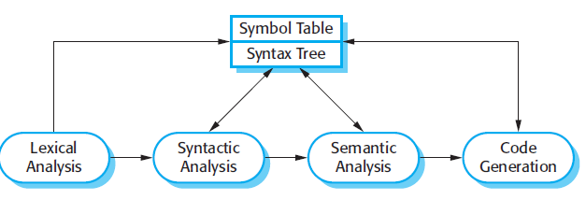
A pipe and filter compiler architecture
Architecture 1
Pipe and filter, using symbol table and syntax tree as repository
Notes:
This pipe and filter model of language compilation is effective in batch environments
where programs are compiled and executed without user interaction
But….. integrated with other language processing tools such as formatter, then changes from one component need to be reflected immediately in other components.
It is better to organize the system around a repository

Slide 38
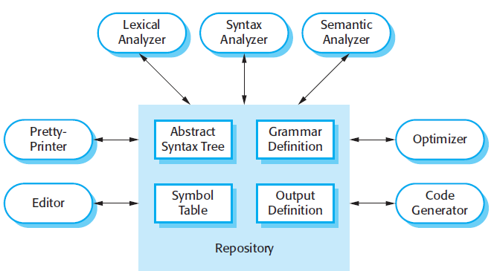
A repository architecture for a language processing system
Architecture 2
a syntax-directed editor can check that the syntax of a program is correct as it is being typed
a prettyprinter can create listings of the program in a format that is easy to read.

